Slide 1
Agricultural Related Query Clarifier System
Name: VIJAI KUMAR S
Register No: 2020178060(R)
Batch: Batch 2
Project Guide: Dr.D.NARASHIMAN
Notes:
We designed this template so that each member of the project team has a set of slides with its own theme. Members, here’s how you add a new slide to just your set:
Mark where you want to add the slide: Select an existing one in the Thumbnails pane, click the New Slide button, then choose a layout. The new slide gets the same theme as the other slides in your set.
Careful! Don’t annoy your fellow presenters by accidentally changing their themes. That can happen if you choose a different theme from the Design tab, which changes all of the slides in the presentation to that look.

Slide 2
Problem Statement
Traditionally Field officers visit the farmlands and provide training, advice, and support to the farmers
Many of the rural villages misses this facility
Wastage of time and money spent on obtaining information or contacting officials
Nowadays many young generation people are come forward in Agricultural field
By this they are struggled to clarify their any basic doubts about farming. Lots of people are calling Kissan Call Centre (Owned by Government) to clarify their basic doubts

Slide 3
Literature Survey
S No | Title & Author | Journal/ Conference | Volume/ Issue & page No | Methodology | Dataset | Result | Pros & cons
1 | Stopwords in technical language processing Serhad Sarica , Jianxi Luo | Journal PLOS ONE | 16/8: e0254937. https://doi.org/10.1371/journal.pone.0254937 | Term frequency Term-frequency-inverse-document-frequency Entropy | Patent database as the data source | Automatically identify candidate stopwords | Stopwords list can be used as a complementary list to NLTK Improper selection and removal of stop words can change the meaning of our text
2 | A simple but tough-to-beat baseline for sentence embedding's. Sanjeev Arora, Yingyu Liang, Tengyu Ma | conference International Conference on Learning Representations2017 | --- | Word embeddings. Phrase/Sentence/Paragraph embeddings. | SemEval semantic textual similarity (STS) (2012-2015) SemEval 2015 Twitter task SemEval 2014 Semantic Relatedness task | This provided a simple approach to sentence embedding. based on the discourse vectors in the random walk model for generating text | It is simple and unsupervised, but achieves significantly better performance than baselines on various textual similarity tasks Has known limitations for capturing sentiment due to the “antonym problem”, (b) also in our weighted average scheme, words like “not” that may be important for sentiment analysis are down weighted a lot
3 | An algorithm that learns what’s in a name. Bikel, Daniel M., Richard Schwartz, and Ralph M. Weischedel | Journal Machine Learning 1999 | 34/ 211–231 | Named entity extraction | 30 Wall Street Journal documents Spanish test set is from materials used in MET-1, comprised of articles from the news agency | Finding names and other numerical entities tasks can be performed with “near-human performance” | This system is largely language-independent

Slide 4
Literature Survey
S No | Title & Author | Journal/ Conference | Volume/ Issue & page No | Methodology | Dataset | Result | Pros & cons
4 | Word2vec Parameter Learning Explained Rong, Xin. | University of Sao Paulo | https://doi.org/10.1371/journal.pone.0254937 | Continuous bag of word module Skip Gram | Social media search data | Converting word in a vector form | Containing the vector model of words. Same values of vector can gives to another word

Slide 5
Architecture Diagram
Text Inputs
DataSet
Text Pre-Processing
Stop Word Removal
Spell check
Stemming
Remove Redundancy using Synonyms
Language Translation
Pre Processed Input text
Pre Processed Data Set
containing the query, query-type, state, district, time of query and the list of answers corresponding to that query)
Database
Embedding Optimization
Entity Extractor
Model Training
Word2Vec model
Sentence Embedding
Question Routing
Answer for given Query

Slide 6
Module Description
User Registration/ Login
Preprocessing and Model Training
Database

Slide 7
User Registration/Login
The user module allows users to register, log in, and log out.
In this module user can give their location and basic details which helps for retrieval of data
Users benefit from being able to sign on because this associates content they create with their account and allows various permissions to be set for their roles.

Slide 8
Pre-processing and Model Training
Pre-processing step includes for both user input query and collected dataset.
Stop Word Removal
Spell Check
Stemming
Reduce Redundancy using Synonyms
Language Translation.
For model training data frame is separated into the train (80%) and test (20%).
Train the data set in Word2Vec model. This algorithm users a neural network model to learn word associations from a large corpus of text. Once trained, such a model can detect synonymous words or suggest additional words for a partial sentence.
Entity Extractor is used to extract the noun from the user input like Crop name, State, etc.

Slide 9
Database
Database was fully organized with our trained dataset.
Dataset will be stored in common database which can accessed by only registered user.
After pre-processing the user query, it will be sent to host server.
Based on the vector, predicted answer will be fetched from the database for the user.

Slide 10
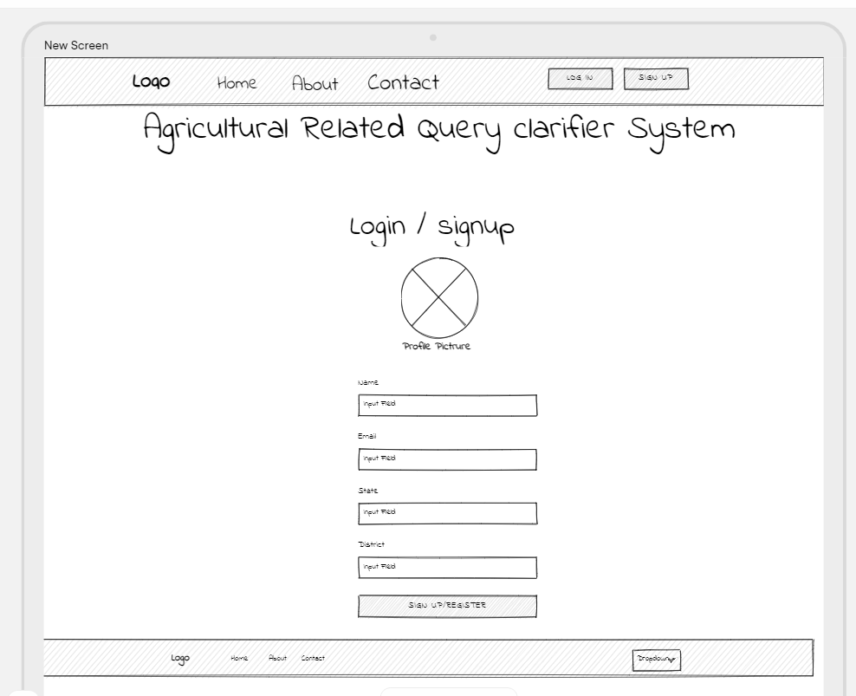
User Interface Screen Shots
Login page

Slide 11
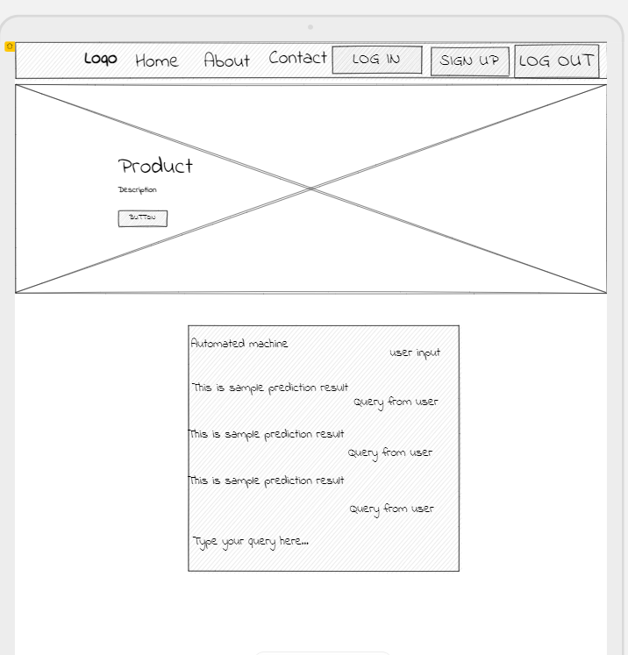
User Interface Screen Shots
Query Clarifier page

Slide 12
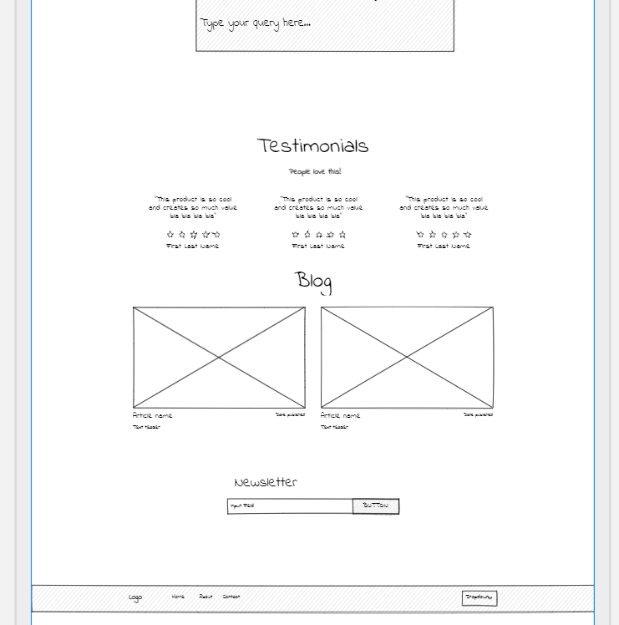
User Interface Screen Shots
Query Clarifier page

